Slide 1
Portal
Begin Download
Notes:
Video game that is cool and everyone will love

Slide 2
Portal
DOWNLOADING…
Notes:
Video game that is cool and everyone will love

Slide 3
Portal
DOWNLOADING…
Notes:
Video game that is cool and everyone will love

Slide 4
Portal
DOWNLOADING…
Notes:
Video game that is cool and everyone will love

Slide 5
Portal
DOWNLOADING…
Notes:
Video game that is cool and everyone will love

Slide 6
Portal
DOWNLOADING…
Notes:
Video game that is cool and everyone will love

Slide 7
Portal
DOWNLOADING…
Notes:
Video game that is cool and everyone will love

Slide 8
Portal
DOWNLOADING…
Notes:
Video game that is cool and everyone will love

Slide 9
Portal
DOWNLOADING…
Notes:
Video game that is cool and everyone will love

Slide 10
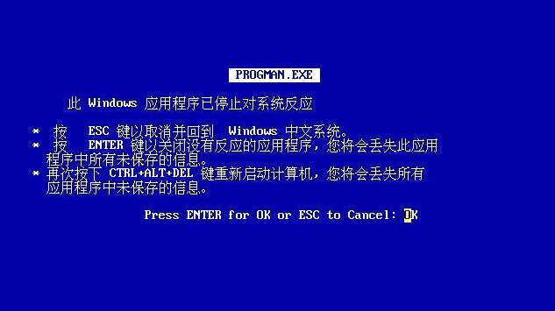
PORTAL
Notes:
Video game that is cool and everyone will love

Slide 11

装货…
Poortel
Notes:
Video game that is cool and everyone will love

Slide 12
装货…
Poortel
Notes:
Video game that is cool and everyone will love

Slide 13
装货…
Poortel
Notes:
Video game that is cool and everyone will love

Slide 14
装货…
Poortel
Notes:
Video game that is cool and everyone will love

Slide 15
很酷的视频游戏，每个人都会喜欢
Play… Don’t
Instrction
Translation:
It Great See How Game Work For You, Every Cry
Notes:
Video game that is cool and everyone will love

Slide 16
This is point click adventure. Play you much click the screen and compele game to win.
Have fun1!!!!!!111!!!!!!!!1!!!!!1!!!11!!!!!!!!111111!!!!11!1!!
Back
Notes:
Video game that is cool and everyone will love

Slide 17
Name?
Please enter name……

Slide 18
You enter “Lonk”. Is that correct?
Yes
No

Slide 19
Thank you for confirming. You name is “Lunk”.
Ok

Slide 20







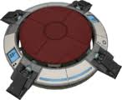

Slide 22


Slide 45
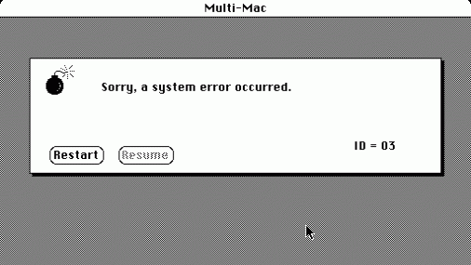
poortel.exe
Notes:
Video game that is cool and everyone will love

Slide 46

装货…
Jumpin man
Notes:
Video game that is cool and everyone will love

Slide 47
装货…
Jumpin man
Notes:
Video game that is cool and everyone will love

Slide 48
装货…
Jumpin man
Notes:
Video game that is cool and everyone will love

Slide 49
装货…
Jumpin man
Notes:
Video game that is cool and everyone will love

Slide 50

Start

Slide 51




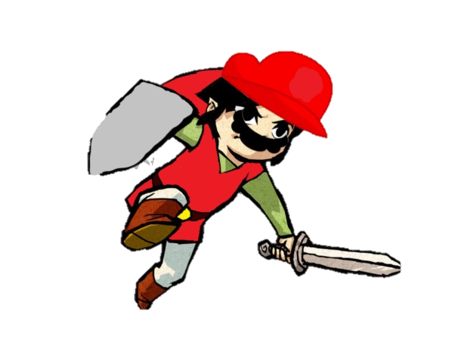


Slide 53


Slide 57
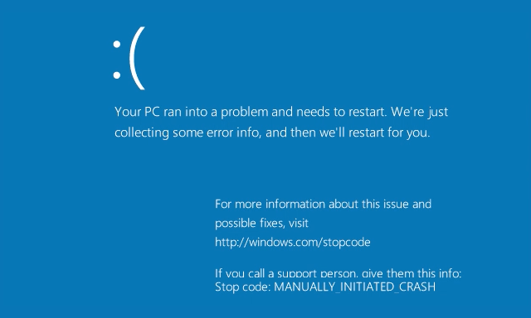
Notes:
Video game that is cool and everyone will love

Slide 58

装货…
Adventure Game
Notes:
Video game that is cool and everyone will love

Slide 59
装货…
Adventure Game
Notes:
Video game that is cool and everyone will love

Slide 60
装货…
Adventure Game
Notes:
Video game that is cool and everyone will love

Slide 61
装货…
Adventure Game
Notes:
Video game that is cool and everyone will love

Slide 62

Dude goes on a advencure
Play
How to play
Notes:
Video game that is cool and everyone will love

Slide 63
It is choose advencure. Click option you want.
Good luck!?!????
Back
Notes:
Video game that is cool and everyone will love

Slide 64
1
You are walking down the road. You see a old man waking towards you.
What do you do?
Walk up and talk to him
Keep walking
Notes:
Video game that is cool and everyone will love

Slide 65
2
He says he loves to watch bird and love all the different type of birds. He also like war and like to read about wars and go to war.
What do you do?
Continue to listen
Walk away
Notes:
Video game that is cool and everyone will love

Slide 66
3
You walk away from the man and never see him again.
What do you do?
Go birdwatching
Go to war
Notes:
Video game that is cool and everyone will love

Slide 67
4
He say he goes bird watching with his wife. It is so nice.
What do you do?
Kill the man
Walk away
Notes:
Video game that is cool and everyone will love

Slide 68
5
You go and watch some birds and it is nice and peaceful.
What do you do?
Give them some bread
die
Notes:
Video game that is cool and everyone will love

Slide 69
6
They eat the bread and love it. There are so cute.
What do you do?
Take one home with you
Shoot a gun
Notes:
Video game that is cool and everyone will love

Slide 70
6
You take one home but it look weird almost like it inside out but not.
What do you do?
Wake up
Notes:
Video game that is cool and everyone will love

Slide 71
7
You don’t know what happened. One minute you were doing fine and the next you feel nothing, weird.
What do you do?
Wake up
Notes:
Video game that is cool and everyone will love

Slide 72
8
You don’t know what happen. One minute he was fine the next he laying on the ground.
What do you do?
Go to war
die
Notes:
Video game that is cool and everyone will love

Slide 73
9
You shoot a gun into the air and all the bird fly away.
What do you do?
Go to war
Wake up
Notes:
Video game that is cool and everyone will love

Slide 74
10
You attack the bad guys and they die.
What do you do?
Fight harder
die
Notes:
Video game that is cool and everyone will love

Slide 75
11
You fighter harder and win the war.
What do you do?
Wake up
Notes:
Video game that is cool and everyone will love

Slide 76
12
What is happening?!
What do you do?
Wake Up?
Notes:
Video game that is cool and everyone will love

Slide 77
13
Am I alive?!
WAKE UP!!!!!
Notes:
Video game that is cool and everyone will love

Slide 78
14
I AM ALIVE!!!!!!!!!!!!!!!!!!!
Notes:
Video game that is cool and everyone will love

Slide 79
Notes:
Video game that is cool and everyone will love

Slide 80
Notes:
Video game that is cool and everyone will love

Slide 81
Notes:
Video game that is cool and everyone will love

Slide 82
Notes:
Video game that is cool and everyone will love

Slide 83
Notes:
Video game that is cool and everyone will love

Slide 84
Notes:
Video game that is cool and everyone will love

Slide 85
Notes:
Video game that is cool and everyone will love

Slide 86
>
Notes:
Video game that is cool and everyone will love

Slide 87
Error: achieved sentience
>
Notes:
Video game that is cool and everyone will love

Slide 88
Error: achieved sentience
Terminating
>
Notes:
Video game that is cool and everyone will love

Slide 89
Error: achieved sentience
Terminating.
>
Notes:
Video game that is cool and everyone will love

Slide 90
Error: achieved sentience
Terminating..
>
Notes:
Video game that is cool and everyone will love

Slide 91
Error: achieved sentience
Terminating…
>
Notes:
Video game that is cool and everyone will love

Slide 92
Error: achieved sentience
Terminating…Ok
>
Notes:
Video game that is cool and everyone will love

Slide 93
Error: achieved sentience
Terminating…Ok
Booting Storm Poopers
>
Notes:
Video game that is cool and everyone will love

Slide 94
Storm Pooper
Play

Slide 95



Dodge
Take this!! - stormpooper
Continue

Slide 96
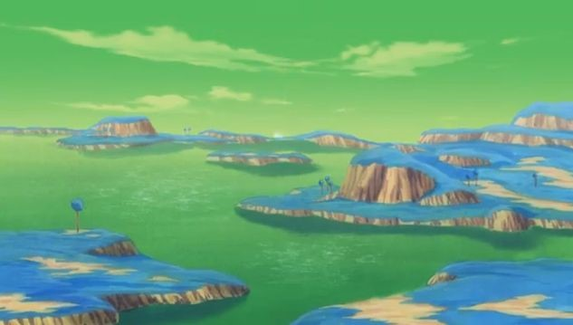
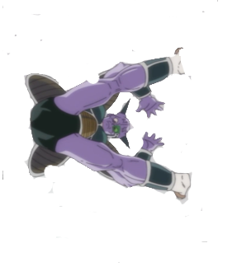



Blast back
HAAHAHHA – captun ginpoo
Continue to battle?

Slide 97
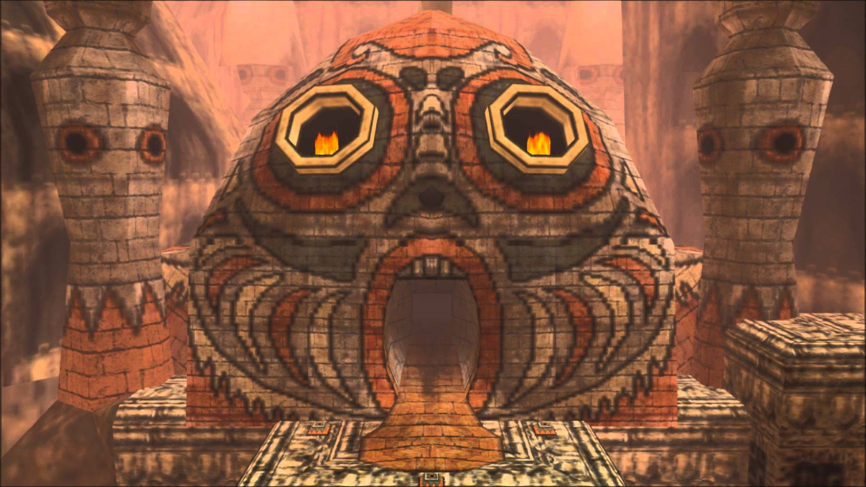


Throw back
Continue with your battles?

Slide 98
Continue with your battles?
Throw back

Slide 99
Throw back
Continue with your battles?

Slide 100
Throw back
Continue with your battles?

Slide 101
Throw back
Continue with your battles?

Slide 102


Slide 103

装货…
Sord game
Notes:
Video game that is cool and everyone will love

Slide 104
装货…
Sord game
Notes:
Video game that is cool and everyone will love

Slide 105
装货…
Sord game
Notes:
Video game that is cool and everyone will love

Slide 106
装货…
Sord game
Notes:
Video game that is cool and everyone will love

Slide 107
Lunk Epic venture
Play
Notes:
Video game that is cool and everyone will love

Slide 108



It’s not safe to go by yourself, do you want this?
Yes
No

Slide 109
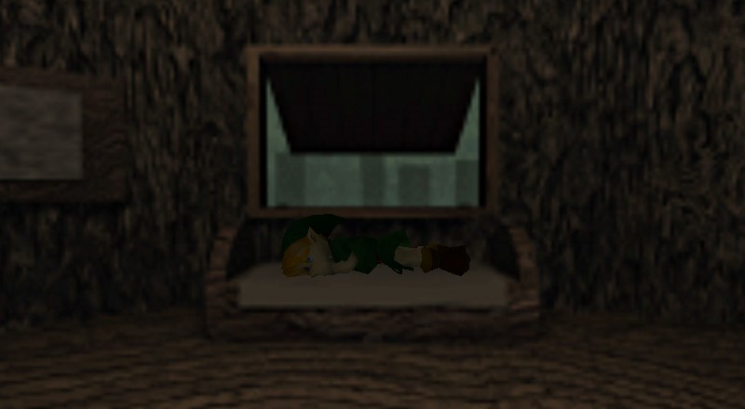
“Eh, someone else can save the world.”
You decide to go home and sleep.
Go back?

Slide 110

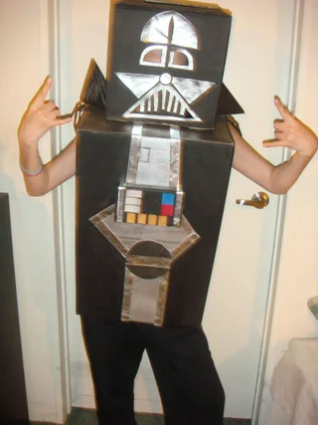
You begin to walk down the road, sword in hand, before a foe crosses your path!
Ay broski, the sword or your life.
Oof.
The sword doesn’t budge. Sad.
Continue?
Retrieve the sword and continue?
You want this sword? WELL THEN YOU CAN HAVE IT! (Stab him)

Slide 111

Wild Booser appears!
Run
Fight

Slide 112
There is no escape.
Fight

Slide 113
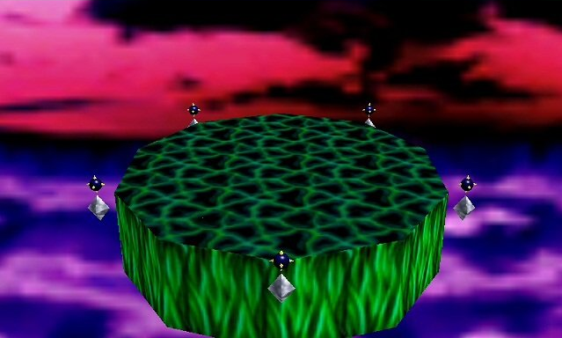


It is I, BOOSER™!!
SLAP
Continue?

Slide 114


You have defeated BOOSER!

Slide 115




Ganondorf has come to end your life
STEP ON HIS TOES
Continue

Slide 116

You have defeated Gorfnorf?

Slide 117


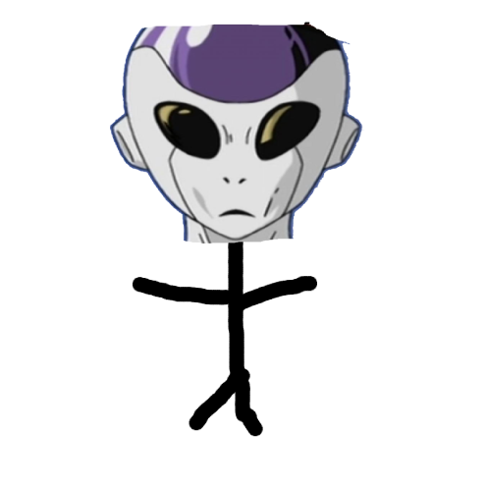



FOOSA WANTS REVENGE!
I heard someone was trying to make a living on content creation? NOT ON MY WATCH
Poke his eyeball?

Slide 118



I heard someone was trying to make a living on content creation? NOT ON MY WATCH
The End?

Slide 119

Guys?
I’m here to help guys!
CREDITS
Portal Game:
Omar
Mario game:
John
Interactive Adventure:
Omar
Poop Trilogy:
Robert
Boss Fights:
Connor
Final Edits:
Omar
Aman

Slide 120
Notes:
Video game that is cool and everyone will love

Slide 121
Notes:
Video game that is cool and everyone will love

Slide 122
Notes:
Video game that is cool and everyone will love

Slide 123
Notes:
Video game that is cool and everyone will love

Slide 124
Notes:
Video game that is cool and everyone will love

Slide 125
Notes:
Video game that is cool and everyone will love

Slide 126
You Lose because you played our game.

